Slide 1
Angular change detection & performance tuning
Nir Oren
Jan. 2019

Slide 2
Change detection

Slide 3
Change detection intro
Change detection role is to detect a change and reflect it in the UI.
Change can occur when a button was clicked (DOM event), XHR, other asynch events (like set-timeout)

Slide 4
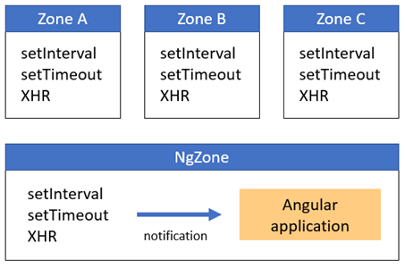
Zone.Js
ZoneJs is a library - not part of Angular !!!
The library simply provides a way to intercept async event - monkey patch.
Angular use ZoneJs to intercept changes which engage the CD.
ZoneJs introduce the concept of zones, you can have many different zones on a web page.
Angular define a dedicated zone named NgZone
Angular only gets notifications about events that occur inside this zone.

Slide 5
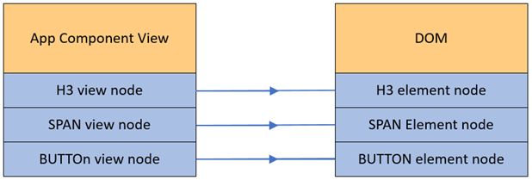
Binding
The most granular object is view
View has component property (1 to 1 relation)
During the compilation for each DOM element (that might be updated during the CD) the compiler create biding
When Angular checks a view, it simply runs over all bindings generated for a view by the compiler.
When an asynchronous event takes place, Angular triggers change detection on its top-most ViewRef, which after running change detection for itself runs change detection for its child views.

Slide 6
Demo

Slide 7
Performance boost

Slide 8
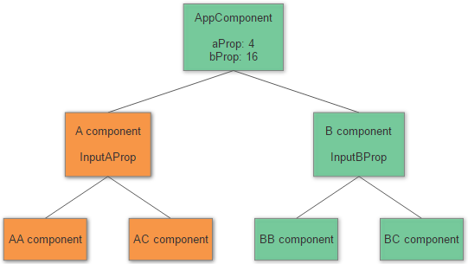
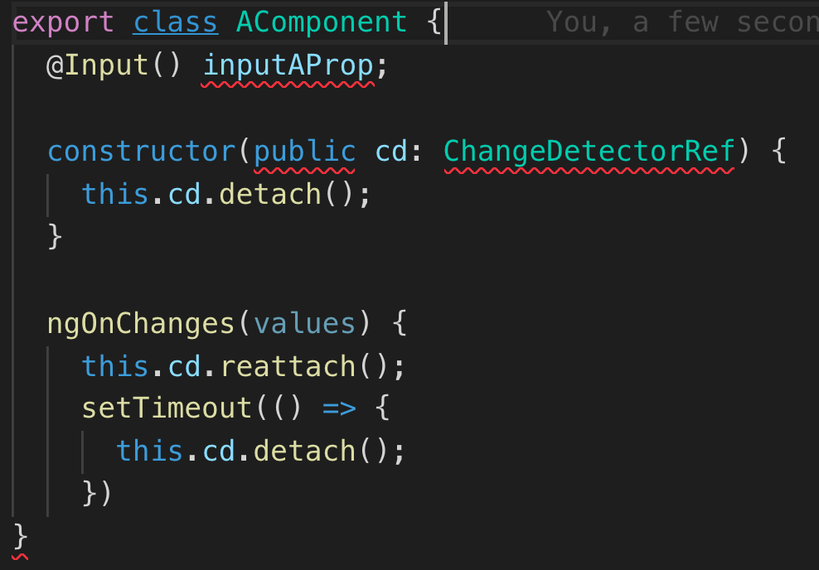
ChangeDetectorRef
Detach & Reattach - disables/enables checks for the current view
markForCheck markForCheck force the change detection for all parent components up to the root.
detectChanges run change detection once for the current component and all its children
checkNoChanges ensures that there will be no changes done on the current run of change detection

Slide 9
Change detection strategy - OnPush
Angular component CD only depends on its @inputs – Pure concept
Component will be checked:
The Input reference changes -> immutable objects
An event originated from the component / children -> internal state ONLY DOM EVENTS !!! XHR will not trigger CD
We run change detection explicitly

Slide 10
Controlling CD with NgZone
NgZone is “An injectable service for executing work inside or outside of the Angular zone”
Methods
Run – run inside the zone
runOutsideAngular
…

